Slide 1
Dynamic Programming
CS208
by wwy

Slide 2

eg:Fibonacci
0, 1, 1, 2, 3, 5, 8, 13, 21......
$$f(x)=\left\{\begin{aligned}0, x=0; \\ 1, x=1; \\ f(x−1)+f(x−2), x≥2\end{aligned}\right.$$
function f(x){
if(x==0) return 0;
if(x==1) return 1;
else return f(x-1)+f(x-2);
}

Slide 3
DFS->DP
function f(x){
if(x==0) return 0;
if(x==1) return 1;
else return f(x-1)+f(x-2);
}
function f(x){
int[] dp = new int[x+1];
dp[0]=0;
dp[1]=1;
for(int i=2;i<x+1;i++){
dp[i]=dp[i-1]+dp[i-2];
}
return dp[x];
}
DP use array to store fore-results
time -> space

Slide 4
Steps of DP
determine state(function)
determine transition function/matrix (recursion relationship)
determine Boundary conditions
determine recursion order

Slide 5
Types of DP
linear
Interval
State compression
tree

Slide 6
eg: 01 knapsack
m kg total, n kinds of goods(each kind has only one), the weight of each goods is Wi (1<=i<=n) and value is Ci (1<=i<=n), to get the Max value
Input: n kinds, m capacity
Max value->f(i,j)->f[i][j]
f[i][j] means the value of i kinds of goods put in bag capacity j
the final Max value is: kinds i from 0 to n; capacity j from 0 to m
f[n][m]

Slide 7

for(i=1;i<=n;i++){//goods
for(j=1;j<=m;j++){//capacity
if(j<w[i])f[i][j]=f[i-1][j];
else
f[i][j]=max(f[i-1][j],f[i-1][j-w[i]]+c[i]);
}
}
printf(“%d”,f[n][m])
n m
Wi Ci
i
0
1
2
3
j 0 1 2 3 4 5 6
0
0
0
0
0
0
0
w,c
0
0
0
0
0
0
0
3,5
0
0
0
0
0
0
0
2,3
0
0
0
0
0
0
0
4,6

Slide 8
for(i=1;i<=n;i++){//goods
for(j=1;j<=m;j++){//capacity
if(j<w[i])f[i][j]=f[i-1][j];
else
f[i][j]=max(f[i-1][j],f[i-1][j-w[i]]+c[i]);
}
}
printf(“%d”,f[n][m])
n m
Wi Ci
i=0:
f[1]=0;
f[2]=0;
f[3]=0;
f[4]=0;
f[5]=0;
f[6]=0;
i=1:
f[3]=f[0]+5=5;
f[4]=f[1]+5=5;
f[5]=f[2]+5=5;
f[6]=f[3]+5=5;
i=2:
f[2]=f[0]+3=3;
f[5]=f[3]+3=8;
f[5]=f[3]+3=8;
i=3:
f[4]=f[2]+3=6;
f[6]=f[4]+3=9;
i
0
1
2
3
j 0 1 2 3 4 5 6
0
0
0
0
0
0
0
w,c
0
0
0
5
5
5
5
3,5
0
0
3
5
5
8
8
2,3
0
0
3
5
6
8
9
4,6

Slide 9
eg: complete knapsack
m kg total, n kinds of goods(each kind has enough), the weight of each goods is Wi (1<=i<=n) and value is Ci (1<=i<=n), to get the Max value
Input: n kinds, m capacity
Max value->f(i,j)->f[i][j]
f[i][j] means the value of i kinds of goods put in bag with capacity j
the final Max value is: kinds i from 0 to n; capacity j from 0 to m
f[n][m]

Slide 10


for(i=1;i<=n;i++){//goods
for(j=1;j<=m;j++){//capacity
if(j<w[i])f[i][j]=f[i-1][j];
else
f[i][j]=max(f[i-1][j],f[i][j-w[i]]+c[i]);
}
}
printf(“%d”,f[n][m])
n m
Wi Ci
i
0
1
2
3
j 0 1 2 3 4 5 6
0
0
0
0
0
0
0
w,c
0
0
0
0
0
0
0
2,3
0
0
0
0
0
0
0
4,7
0
0
0
0
0
0
0
3,6

Slide 11
for(i=1;i<=n;i++){//goods
for(j=1;j<=m;j++){//capacity
if(j<w[i])f[i][j]=f[i-1][j];
else
f[i][j]=max(f[i-1][j],f[i][j-w[i]]+c[i]);
}
}
printf(“%d”,f[n][m])
n m
Wi Ci
i
0
1
2
3
j 0 1 2 3 4 5 6
i=1:
f[1][1]=f[0][1]=0;
f[1][2]=f[1][0]+3=3;
f[1][3]=f[1][1]+3=3;
f[1][4]=f[1][2]+3=6;
f[1][5]=f[1][3]+3=6;
f[1][6]=f[1][4]+3=9;
i=2:
f[2][1]=f[0][1]=0;
f[2][2]=f[1][2]=3;
f[2][3]=f[1][3]=3;
f[2][4]=f[2][0]+7=7;
f[2][5]=f[2][1]+7=7;
f[2][6]=f[2][2]+7=10;
i=3:
f[3][1]=f[2][1]=0;
f[3][2]=f[2][2]=3;
f[3][3]=f[3][0]+6=6;
f[3][4]=f[2][4]=7;
f[3][5]=f[3][2]+6=9;
f[3][6]=f[3][3]+6=12;
0
0
0
0
0
0
0
w,c
0
0
3
3
6
6
9
2,3
0
0
3
3
7
7
10
4,7
0
0
3
6
7
9
12
3,6

Slide 12
eg: Longest Common Sequence
give two string, please calulate the length of longest common sequence
Input: ADABEC, DBDCA
Output:3
A D A B E C
i
D B D C A
j
f[i][j]

Slide 13
A D A B E C
i
D B D C A
j
A D A B E C
i
D B D C A
j
f[i][j]=f[i-1][j-1]+1
f[i][j]=f[i][j-1]
A D A B E C
i
D B D C A
j
A D A B E C
i
D B D C A
j
f[i][j]=f[i-1][j]
f[i][j]=f[i-1][j]?f[i][j-1]?

Slide 14
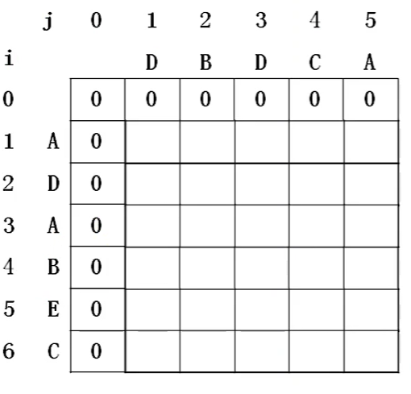
for(i=1;i<m;i++){
for(j=1;j<n;j++){
if(a[i-1]==b[j-1]) f[i][j]=f[i-1][j-1]+1;
else f[i][j]=max(f[i-1][j],f[i][j-1]);
}
}
for(i=1;i<m;i++){//row
for(j=1;j<=n;j++){//column
if(a[i-1]==b[j-1]){
f[i][j]=f[i-1][j-1]+1;
p[i][j]=1;//left up
}
else if(f[i][j-1]>f[i-1][j]){
f[i][j]=f[i][j-1];
p[i][j]=2;//leftwards
}
else{
f[i][j]=f[i-1][j];
p[i][j]=3;//upwards
}
}
}

Slide 15
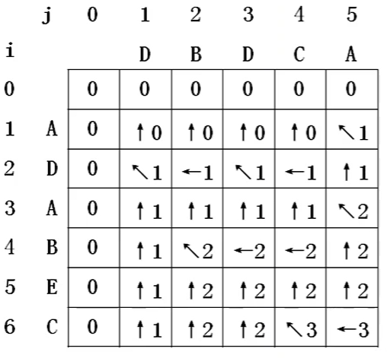
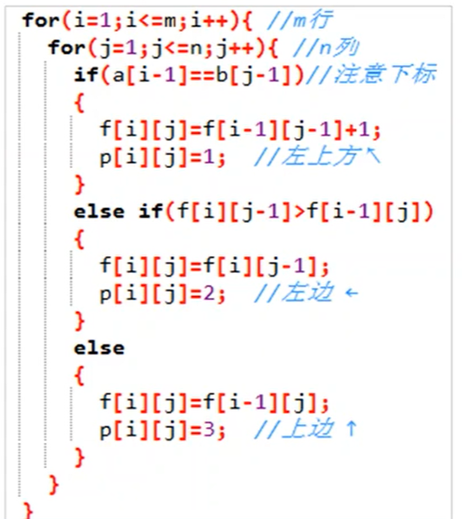
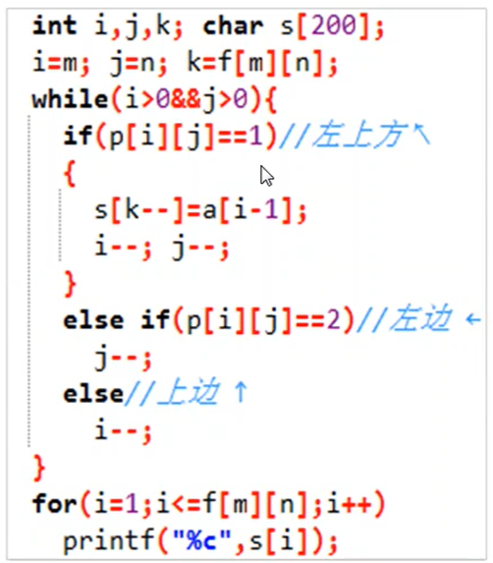
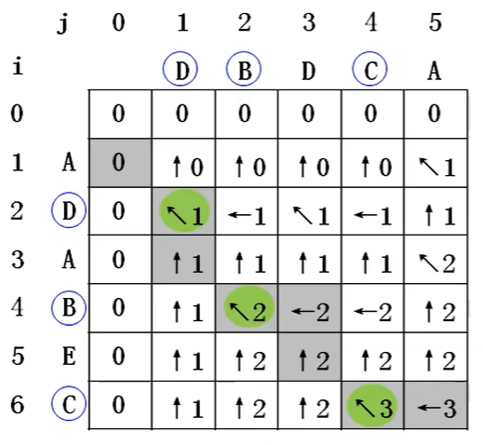
Is P[i][j] necessary?

Slide 16
eg: longest path in a tree
A given tree with N nodes, and N-1 edges, every edge has weight wi
find longest path(Max(Sum{wi|wi of path}))
Input
Output: distance of longest path(here 22)
6
5 1 6
1 4 5
6 3 9
2 6 8
6 1 7

Slide 17
Any node U
Search downward from U, collection wi when return
d(u)=d1+d2
d1: distance of longest path downward from u
d2:distance of second longest path downward from u
result = Max(result,d(i))
u
j
j
j
Is d[i] necessary?
result = Max(result, d1+d2), result is global value

Slide 18
const int N=10010, M=N*2;
int n, result;
bool vis[N];
int h[N], e[M], w[M], ne[M], idx;//adjacent set
void add(int a, int b, int c){//store edge with adjacent set
e[++idx]=b;// e--end
w[idx]=c;//w--weight
ne[idx]=h[a];//ne--next
h[a]=idx;//h--head
}
int main(){
memset(h, -1, sizeof(h));
cin>>n;
for(int i=1; i<n;++i){
int a,b,c;
cin>>a>>b>>c;
add(a, b, c); add(b, a, c);
}
dfs(1);
cout<<result<<endl;
return 0;
}
int dfs(int u){
vis[u]=true;//sign if u has been visited
int d1 = 0;//longest distance downward from u
int d2 =0;//2nd longest distance downward from u
for(int i=h[u]; i!=-1; i=ne[i]){//i is index of edge
int j=e[i]//j is adjacent node of u
if(vis[j]) continue;
int d =dfs(j)+w[i];
// update d1,d2
if(d>=d1) {d2=d1; d1=d;}
else if(d>d2)d2=d;
}
result = max(result, d1+d2)//update result
result d1;
}

Slide 19
eg:[Compression]Traveling Salesman Problem
A traveling salesman wanna go to all n cities, but only one time for each city.
First, he start from one city and return to the same one at last.
He wanna know the Min value of the path he had passed
O(n²*2^{n})
dp[i][S], i-this city(node), S-set of cities arrived
1
3
4
5
integer->bit
0
2

Slide 20
1
S=(10010)₂
V={1,4}
Min : Only care about this node/passed nodes, no need record path
start state: dp[i][1<<i]=0
transfer func: dp[j][S|(1<<j)]=min(dp[i][S]+W[i][j])
enumerate: for(int S=0;S<(1<<n);S++)
compression
3
4
5
0
2

Slide 21
pseudo-code
for(int S=0;S<(1<<n);S++){
for(int i=1; i<n;i++){
if(S&(1<<i)){
for(int j=0;i<n;j++){
if(!(S&(1<<j)&&W[i][j]))
dp[j][S|(1<<j)]=min(dp[j][S|(1<<i)],dp[i][S]+W[i][j])
}
}
}
}

Slide 22
eg:[interval]combine stones
N groups of stones in a row, numbered as 1,2,3,...,N
Every group of stone has its own energy a_{i}(i=1,2,3,...,N), you can combine neighbour two groups(i,i+1) to one which has enery(a_{i}+a_{i+1}) ,and also cost(a_{i}+a_{i+1})
Find a strategy to combine all groups to one that cost least
Input: first row N, second row a₁,a₂,...,a_{N}
Output: minimum cost
5
1 3 4 2 5
34

Slide 23
1 3 4 2 5
1 3 4 2 5
K
4 4 2 5
4 4 2 5
DP
4 6 5
4 4 7
L
R
10 5
8 7
15
15
dp(L,R): min cost of interval [L,R]
dp(L,K)+dp(K+1,R)+C(L,K)+C(K+1,R)
dp(L,R)=min(dp(L,R),
dp(L,R)+dp(K+1,R)+S(R)-S(L-1))
dp(i,i)=0, output dp(1,n)
35
34
Prefix Sum
C(L,K)=S(K)-S(L-1)
greedy(short-sighted)

Slide 24
const int N=5010;
int n;
int a[N];
int s[N];
int dp[N][N];
//pre
memset(f,0x3f,sizeof(f));
cin>>n;
for(int i=1;i<=n;i++){
cin>>a[i];
s[i]=s[i-1]+a[i];
dp[i][i]=0;
}
//state transition
for(int len=2; len<=n; len++)
for(int l=1; l+len-1<=n; l++){
int r=l+len-1;
for(int k=l;k<r;k++)
dp[l][r]=min(dp[l][r], dp[l][k]+
dp[k+1][r]+s[r]-s[l-1]);
}
cout<<dp[1][n]<<endl

Slide 25
THX :-)

